Slide 1
Distributed System
(BESE-VII)
POKHARA UNIVERSITY
Compiled by
Er. Madan Kadariya
Assistant Professor
HOD, Department of Information Technology Engineering
Nepal College of Information Technology
Balkumari, Lalitpur

Slide 2
Chapter 2: Distributed Objects and Remote Communication
  References:
  G. Coulouris, J. Dollimore and T. Kindberg; Distributed Systems Concepts and Design,4th Edition.
  Andrew S. Tanenbaum and Maarten van Steen; Distributed Systems: Principles and Paradigms, 2nd Edition.
Distributed System (DS)

Slide 3
Topics
Name Services Introduction Name Services and the Domain Name System
Distributed System (DS)

Slide 4
Introduction
In a distributed system, names are used to refer to a wide variety of resources such as: Computers, services, remote objects, and files, as well as users. Basic design issues for name services, such as the structure and management of the spaces of names recognized by the service and the operations that the name service supports, are outlined and discussed in the context of the Internet Domain Name Service.
Distributed System (DS)

Slide 5
Introduction
Resources are accessed using identifier or reference An identifier can be stored in variables and retrieved from tables quickly. Identifier includes or can be transformed to an address for an object. E.g. NFS file handle, Corba remote object reference.
Distributed System (DS)

Slide 6
Introduction
A name is human-readable value (usually a string) that can be resolved to an identifier or address. Internet domain name, file pathname, process number E.g ./etc/passwd, http://www.cdk3.net/ For many purposes, names are preferable to identifiers The binding of the named resource to a physical location is deferred and can be changed. They are more meaningful to users. Resource names are resolved by name services To give identifiers and other useful attributes.
Distributed System (DS)

Slide 7
Introduction
URL
http://www.cdk3.net:8888/WebExamples/earth.html
DNS lookup
Resource ID (IP number, port number, pathname)
138.37.88.61
8888
WebExamples/earth.html
ARP lookup
file
(Ethernet) Network address
2:60:8c:2:b0:5a
Socket
Web server
Figure 1. Composed naming domains used to access a resource from a URL
Distributed System (DS)

Slide 8
Name Services and the Domain Name System
A name service stores a collection of one or more naming contexts, sets of bindings between textual names and attributes for objects such as computers, services, and users. The major operation that a name service supports is to resolve names. DNS supports a model known as iterative navigation. (Figure 2)
Distributed System (DS)

Slide 9
Name Services and the Domain Name System
NS2
2
Name
1
NS1
servers
Client
3
NS3
A client iteratively contacts name servers NS1–NS3 in order to resolve a name
Figure 2. Iterative navigation
Distributed System (DS)

Slide 10
Name Services and the Domain Name System
Reason for NFS iterative name resolution: This is because the file service may encounter a symbolic link (i.e. an alias) when resolving a name. A symbolic link must be interpreted in the client’s file system name space because it may point to a file in a directory stored at another server. The client computer must determine which server this is, because only the client knows its mount points. DNS offers recursive navigation as an option, but iterative is the standard technique. Recursive navigation must be used in domains that limit client access to their DNS information for security reasons. (Figure 3)
Distributed System (DS)

Slide 11
Name Services and the Domain Name System
NS2
NS2
2
2
1
4
3
NS1
1
NS1
client
client
4
3
5
NS3
NS3
Non-recursive
Recursive
server-controlled
server-controlled
Figure 3. Non-recursive and recursive server-controlled navigation
Distributed System (DS)

Slide 12

Name Services and the Domain Name System
DNS - The Internet Domain Name System DNS is a distributed naming database. The arrangement of some of the DNS database is shown in Figure 4.
Root Domain
Top-Level Domain
net
com
org
Second-Level Domain
nwtraders
Subdomain
west
south
east
sales
FQDN:
SERVER1.sales.south.nwtraders.com
Host: SERVER1
Distributed System (DS)

Slide 13
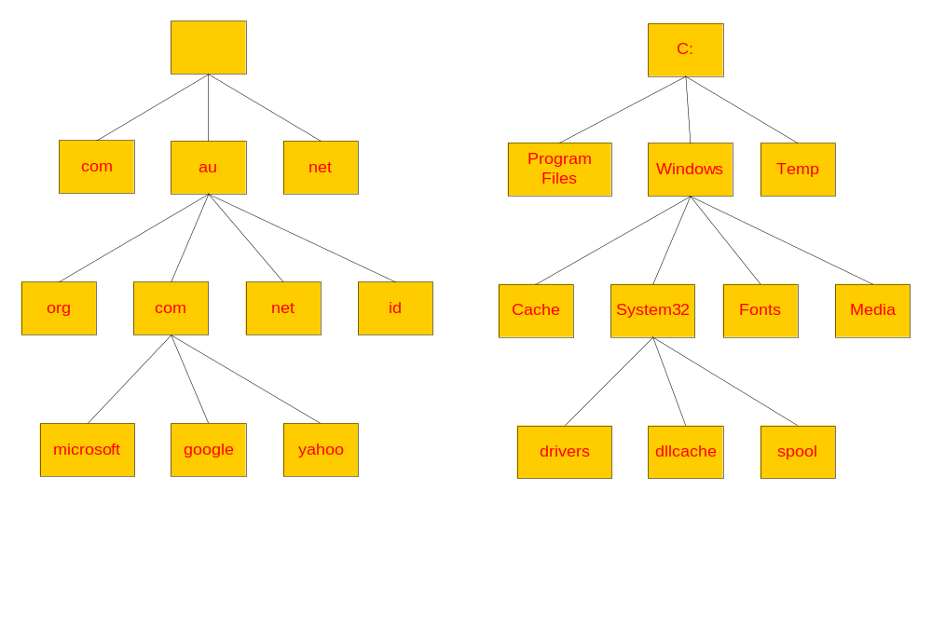
DNS vs File System
Distributed System (DS)

Slide 14
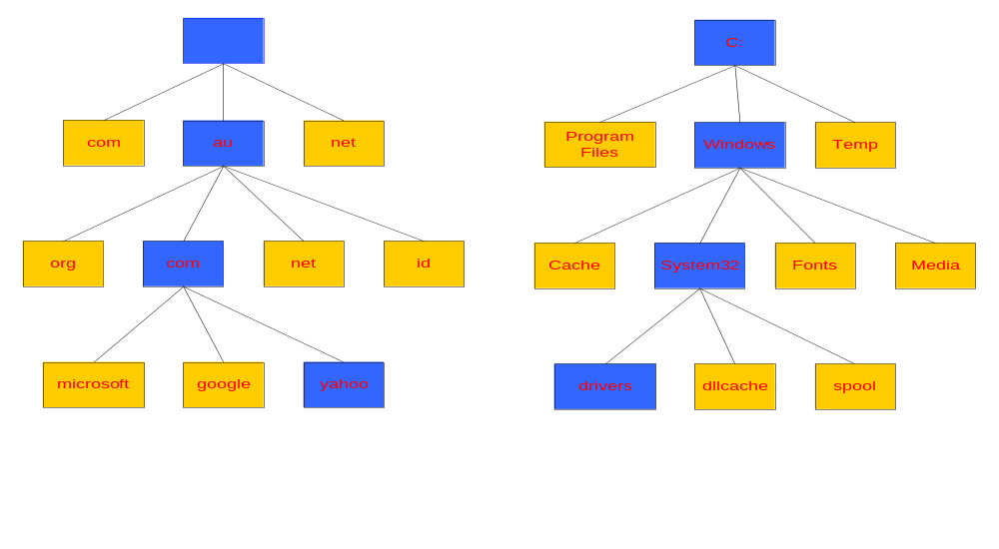
Naming a Domain Naming a Directory
Start Here
Start Here
C:\windows\system32\drivers\
yahoo.com.au.
A “.” is used as separator
A “\” is used as separator
Distributed System (DS)

Slide 15

Standards for DNS Naming
The following characters are valid for DNS names:
A through Z
a through z
0 through 9
Hyphen (-)
The underscore (_) is a reserved character
Distributed System (DS)

Slide 16
Name Services and the Domain Name System
a.root-servers.net
(root)
au
ns1.nic.au
purdue.edu
(au)
yahoo.com
....
Note: Name server names are in italics, and the corresponding domains are in parentheses.
Arrows denote name server entries
ns.purdue.edu
com.au
(purdue.edu)
edu.au
...
ns0.ja.net
(edu.au)
* .purdue.edu
authoritative path to lookup:
raj-pc.csse.unimelb.edu.au
usyd.edu.au
unimelb.edu.au
...
abc.unimelb.edu.au
mulga.csse.unimelb.edu.au
dns0-doc.usyd.edu.au
(unimelb.edu.au)
(csse.unimelb.edu.au)
(usyd.edu.au)
csse.unimelb.edu.au
*.csse.unimelb.edu.au
*.usyd.edu.au
*.unimelb.edu.au
Figure 4. DNS name servers
Distributed System (DS)

Slide 17
Name Services and the Domain Name System
Zone data are stored by name servers in files in one of several fixed types of resource record. (Figure 5)
Distributed System (DS)

Slide 18
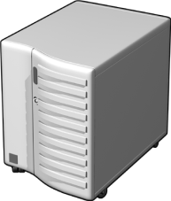







What Are the Components of a DNS Solution?
DNS Clients
DNS Servers
DNS Servers on the Internet
Resource
Record
Root “.”
.com
.edu
Resource
Record
Distributed System (DS)

Slide 19
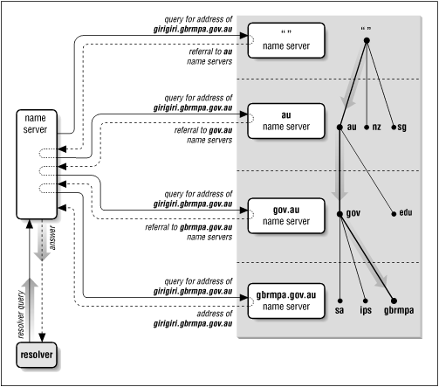
DNS – How it works?
Distributed System (DS)

Slide 20
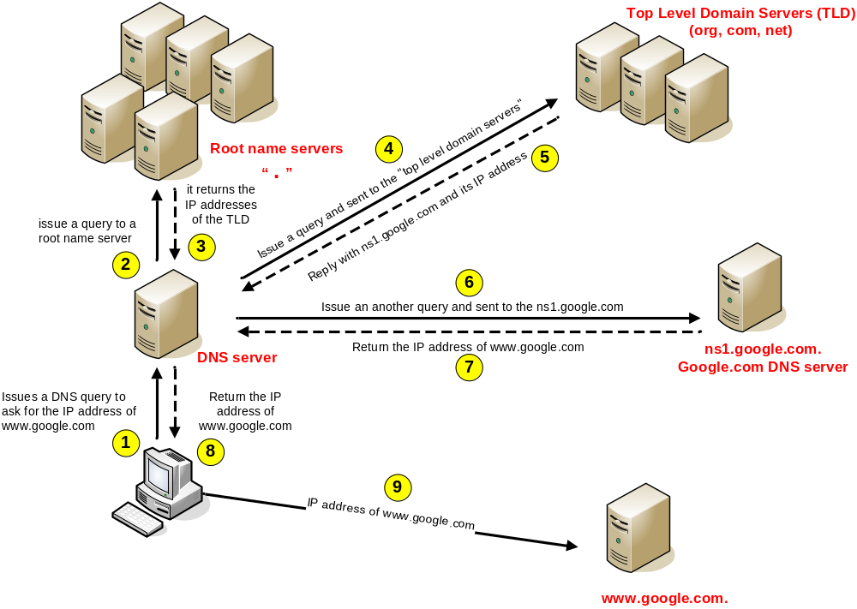
DNS – How it works (mechanism)
Distributed System (DS)

Slide 21
What Is a DNS Query?
A query is a request for name resolution and is directed to a DNS server
Queries are recursive or iterative
DNS clients and DNS servers both initiate queries
DNS servers are authoritative or nonauthoritative for a namespace
An authoritative DNS server for the namespace will either:
  Return the requested IP address
  Return an authoritative “No”
A nonauthoritative DNS server for the namespace will either:
  Check its cache
  Use forwarders
  Use root hints
Distributed System (DS)

Slide 22

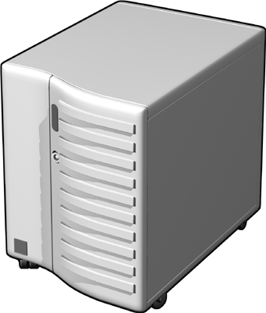

How Recursive Queries Work
A recursive query is sent to a DNS server and requires a complete answer
mail1.contoso.msft
Database
172.16.64.11
DNS Client
Local DNS Server
Distributed System (DS)

Slide 23



How Iterative Queries Work
An iterative query directed to a DNS server may be answered with a referral to another DNS server
Local
DNS Server
Root Hint (.)
Iterative Query
Ask .com
Iterative Query
.com
Ask nwtraders.com
Recursive Query
mail1.nwtraders.com
172.16.64.11
Iterative Query
Authoritative Response
Nwtraders.com
Client Server
Distributed System (DS)

Slide 24

How Forwarders Work
A forwarder is a DNS server designated to resolve external or offsite DNS domain names
Iterative Query
Forwarder
Root Hint (.)
Ask .com
Iterative Query
Ask nwtraders.com
.com
Recursive Query
172.16.64.11
Iterative Query
172.16.64.11
Authoritative Response
Recursive query for
mail1.nwtraders.com
Nwtraders.com
Local
DNS Server
Client Server
Distributed System (DS)

Slide 25




How Root Hints Work
Root hints contain the IP addresses for DNS root servers
Root (.) Servers
DNS Servers
Root Hints
com
DNS Server
microsoft
Client
Distributed System (DS)

Slide 26


How DNS Server Caching Works
DNS server cache
Host name | IP address | TTL
ServerA.contoso.msft | 192.168.8.44 | 28 seconds
Where’s ServerA?
ServerA is at 192.168.8.44
ServerA
Client1
ServerA is at 192.168.8.44
Where’s ServerA?
Client2
Distributed System (DS)

Slide 27
Name Services and the Domain Name System
Record type
Meaning
Main contents
A
A computer address
IP number
NS
An authoritative name server
Domain name for server
CNAME
The canonical name for an alias
Domain name for alias
SOA
Marks the start of data for a zone
Parameters governing the zone
WKS
A well-known service description
List of service names and protocols
PTR
Domain name pointer (reverse
Domain name
lookups)
HINFO
Host information
Machine architecture and operating
system
MX
Mail exchange
List of <
TXT
Text string
Arbitrary text
Figure 5. DNS resource records
Distributed System (DS)

